Slide 1
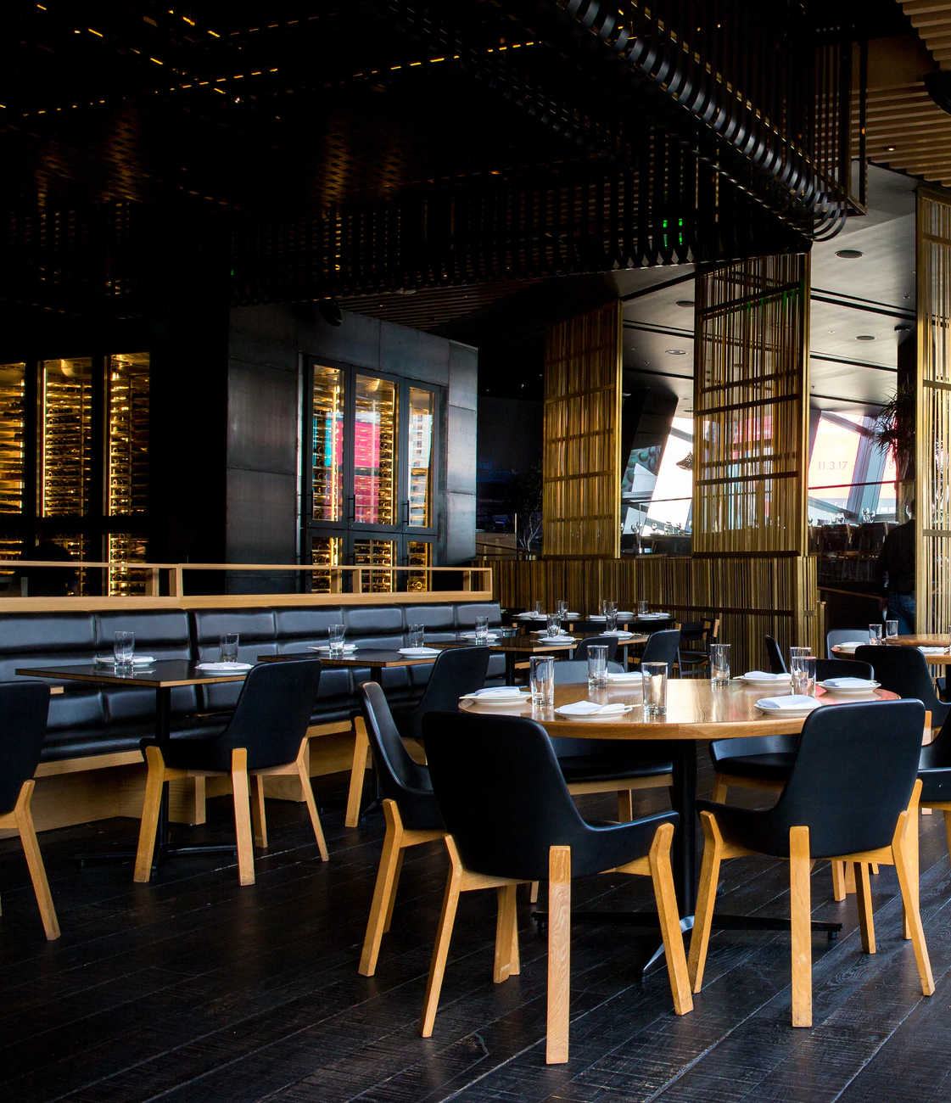
Battle of the Neighborhoods
Evaluation of Restaurant Locations
Joseph George Naduvathuserry

Slide 2
Objective
Build a data driven model to rank potential restaurant locations
Factors
Population
Real estate prices
Competition
Complementary businesses
City Bangalore, India

Slide 3
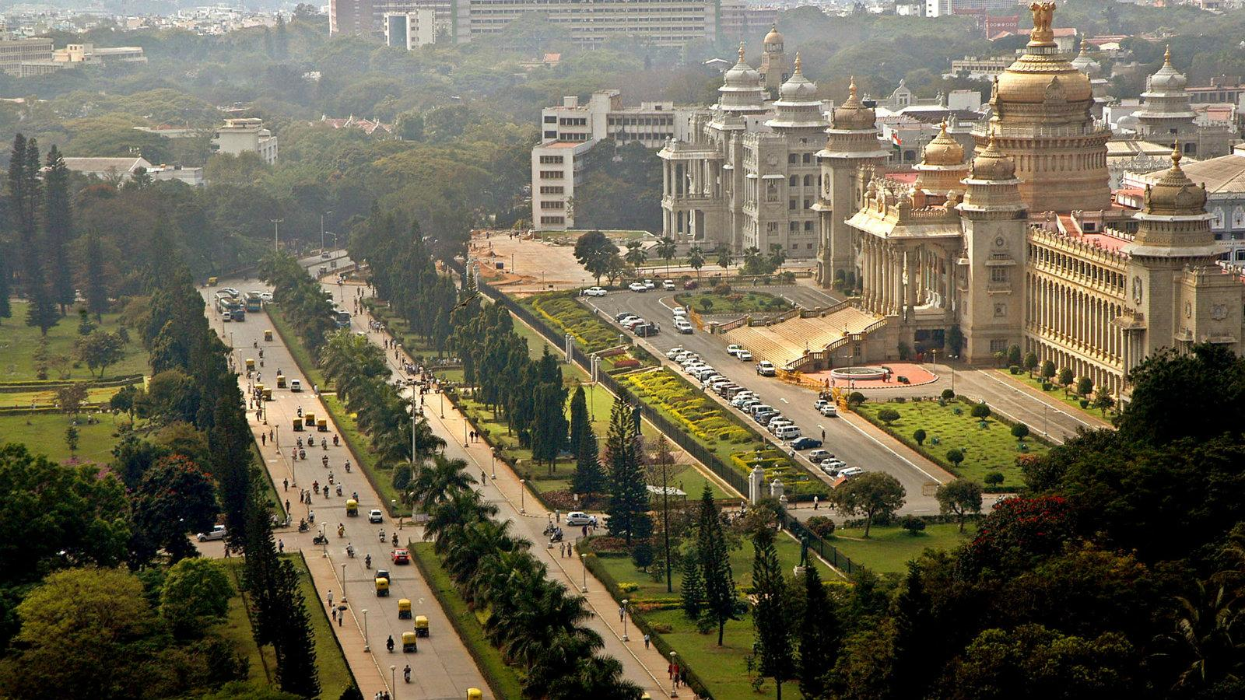
Bangalore, Karnataka

Slide 4





Data Sources
Maps & Population
Points of Interest
(Venue Data)
Nominatim
Geocoding
(Forward and Reverse)
Real Estate Prices

Slide 5





Procedure
Create hexagonal grid map of Bangalore using Uber’s H3 geospatial system
Collect real estate and Foursquare venue data for all hexagons
Build K – means clustering model and study results
Create scoring metric and rank locations

Slide 6
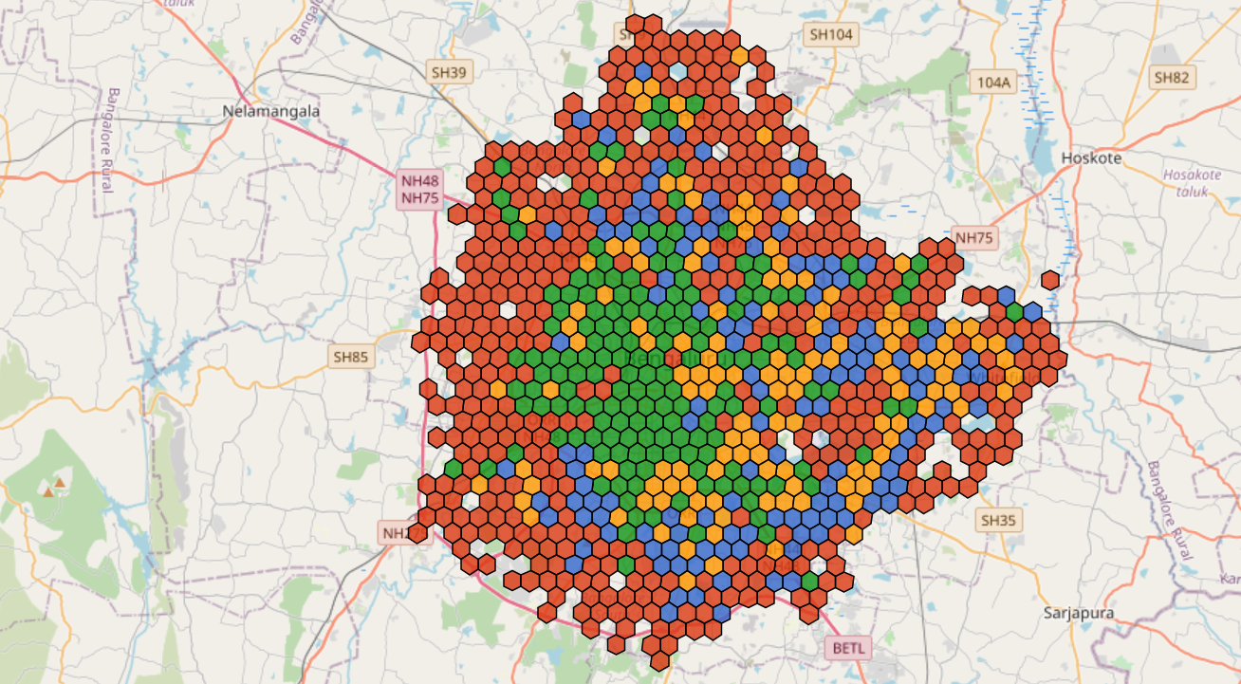
Clustering
Residential
Industrial
Shopping & Entertainment
University & Commercial

Slide 7
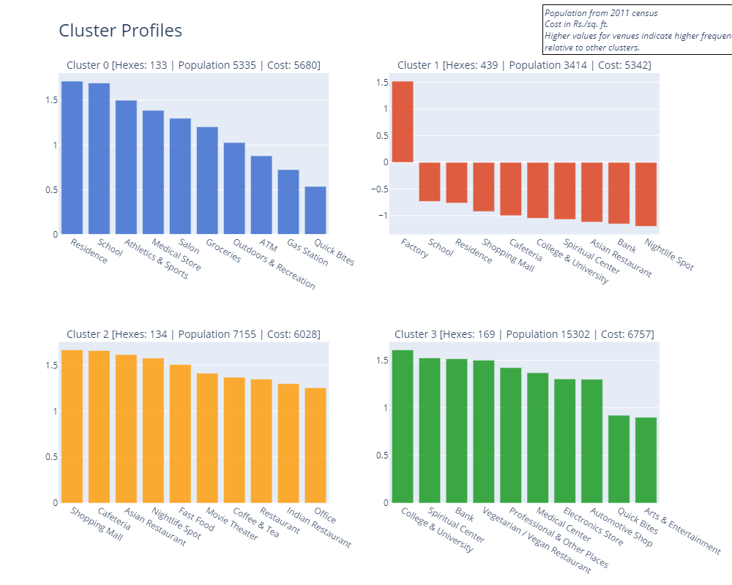
Cluster Profiles
Residential
Industrial

Slide 8
Cluster Profiles
Shopping & Entertainment
University / Commercial

Slide 9

Case 1
Thai/Seafood Restaurant
Format Casual Dining
Target Families, Corporate
Category | Variable | Weight
General | Population | 10
 | Real estate cost (per sq. ft.) | -15
Competition | Asian Restaurant | -10
 | Indian Restaurant | -7
 | Restaurant | -7
 | Vegetarian / Vegan Restaurant | -5
 | Quick Bites | -3
 | Fast Food | -3
Complements | Residence | 15
 | Office | 12
 | Shopping Mall | 10
 | Movie Theater | 10

Slide 10
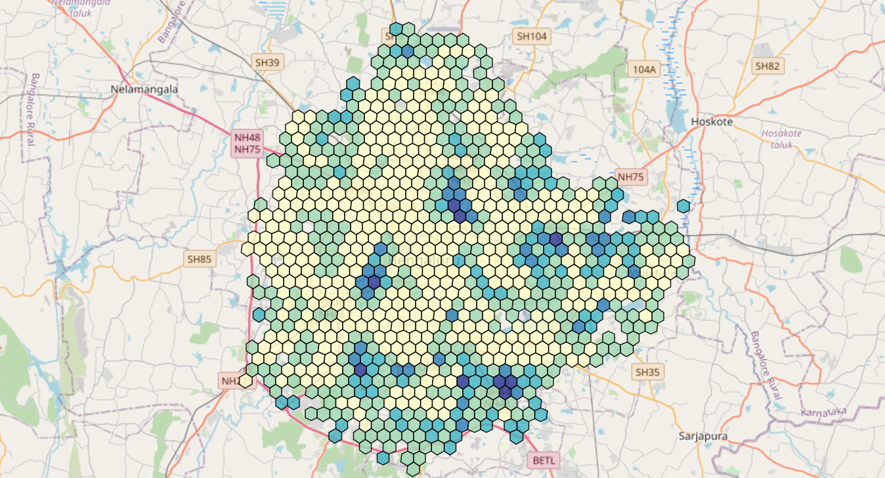
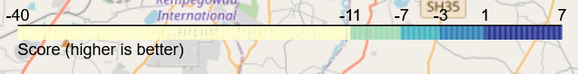
Case 1 Results

Slide 11
Case 1 Results
Residential
Industrial
Shopping & Entertainment
University & Commercial
H3 ID | Cluster | Score | Address
8861892461fffff | 0 | 7.27 | Mangammanapalya, Bommanahalli Zone, Bengaluru - 560068
8861892463fffff | 1 | 3.53 | Mangammanapalya, Bommanahalli Zone, Bengaluru - 560068
8861892439fffff | 0 | 2.96 | Bommanahalli Ward, Bommanahalli Zone, Bengaluru - 560068
8861892eb1fffff | 0 | 2.49 | Richards Town, Sagayarapuram Ward, East Zone, Bengaluru - 560084
8861892eb7fffff | 1 | 2.13 | Muneshwara Nagar, East Zone, Bengaluru - 560084
8860145a2dfffff | 1 | 1.44 | K H Ranganath Colony, Rayapuram Ward, West Zone, Bengaluru - 560026
8861892e03fffff | 0 | 1.34 | Mapple Heights Apartments, Vijnana Nagar, Mahadevapura Zone, Bengaluru - 560093
886189246bfffff | 0 | 0.97 | AECS Layout, A block, Singasandra, Bommanahalli Zone, Bengaluru - 560068
88618924b3fffff | 0 | 0.68 | AGS Layout, Uttarahalli, Bommanahalli Zone, Bengaluru - 560061
8861892ebdfffff | 3 | 0.64 | Lingarajapuram, Lingarajapura Ward, East Zone, Bengaluru - 560043
Top 10 Locations

Slide 12
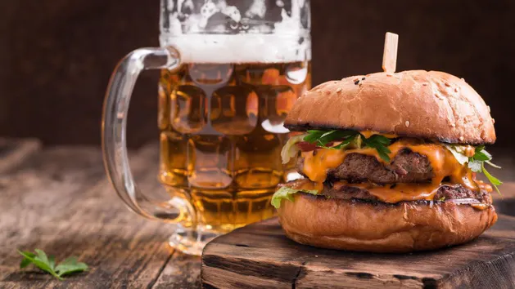
Case 2
Restobar
Format Restobar / Gastropub
Target College students, Young professionals
Category | Variable | Weight
General | Population | 10
 | Real estate cost (per sq. ft.) | -15
Competition | Nightlife Spot | -15
Complements | Residence | 5
 | Office | 10
 | Shopping Mall | 10
 | Movie Theater | 10
 | College & University | 15
 | Arts & Entertainment | 7

Slide 13
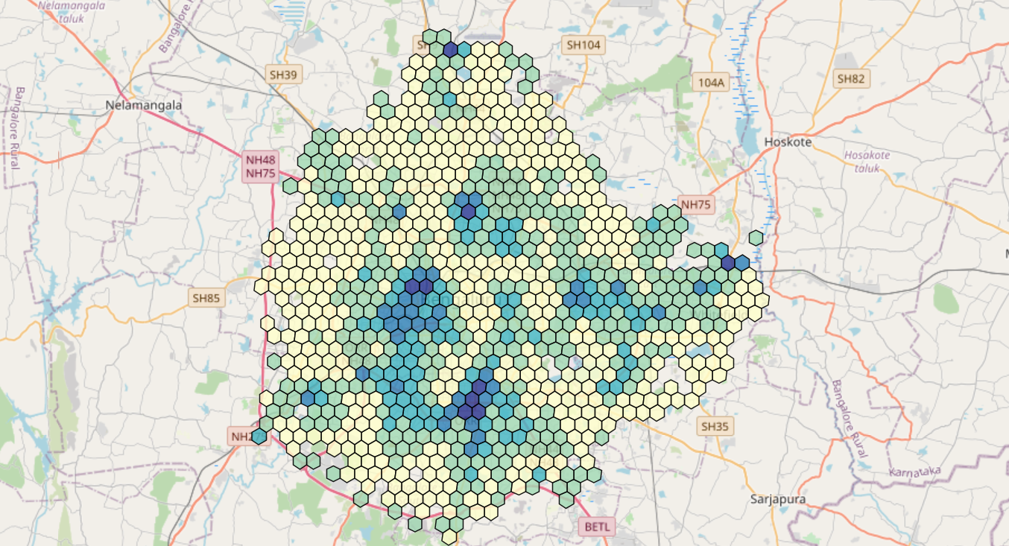
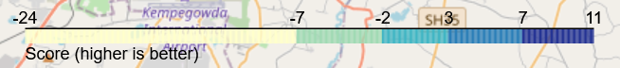
Case 2 Results

Slide 14
Case 2 Results
Residential
Industrial
Shopping & Entertainment
University & Commercial
H3 ID | Cluster | Score | Address
8860145b1dfffff | 3 | 11.47 | Hospital-ayurvedic Homeo Clinic, 2nd Main Road, Prakash Nagar Ward, West Zone, Bengaluru - 560021
88618925d9fffff | 2 | 8.63 | MICO Layout, BTM Layout Ward, South Zone, Bengaluru - 560069
8861892185fffff | 3 | 8.52 | Kadugodi, Mahadevapura Zone, Sheegehalli, Bengaluru - 560067
8860145b0bfffff | 3 | 8.24 | Ramachandra Pura, Okalipuram Ward, West Zone, Bengaluru - 560020
88618925d5fffff | 3 | 7.80 | Bismillah Nagar, Gurappanapalya Ward, South Zone, Bengaluru - 560029
88618925dbfffff | 3 | 7.69 | JP Nagar 2nd Phase, South Zone, Bengaluru - 560069
8861892cd7fffff | 0 | 7.54 | 4th Cross Road, Anandanagar, Hebbala Ward, East Zone, Bengaluru - 560032
8860169625fffff | 1 | 7.21 | Chowdeswari Ward, Yelahanka Zone, Bengaluru - 560064
88618925d1fffff | 2 | 7.19 | Sahakari Vidyakendra AHPS Jayanagar, East End B Main Road, NAL Layout, Jayanagar East Ward, Bengaluru - 560069
8860145b03fffff | 3 | 7.08 | 7th Main Road, Sriramapura, Dayananda Nagar Ward, West Zone, Bengaluru - 560003
Top 10 Locations

Slide 15
Conclusion
Model Evaluation
Future Plans
Model produced good results for both cases
Top 10 results for each generally consisted of the expected clusters
Factor selection and weighting important
Model is flexible enough for different scenarios
Additional and updated economic and demographic information – income, age profiles, etc.
More detailed restaurant data – ratings, prices, cuisines
Allows better segmentation – both of customers and competition.

